Slide 1
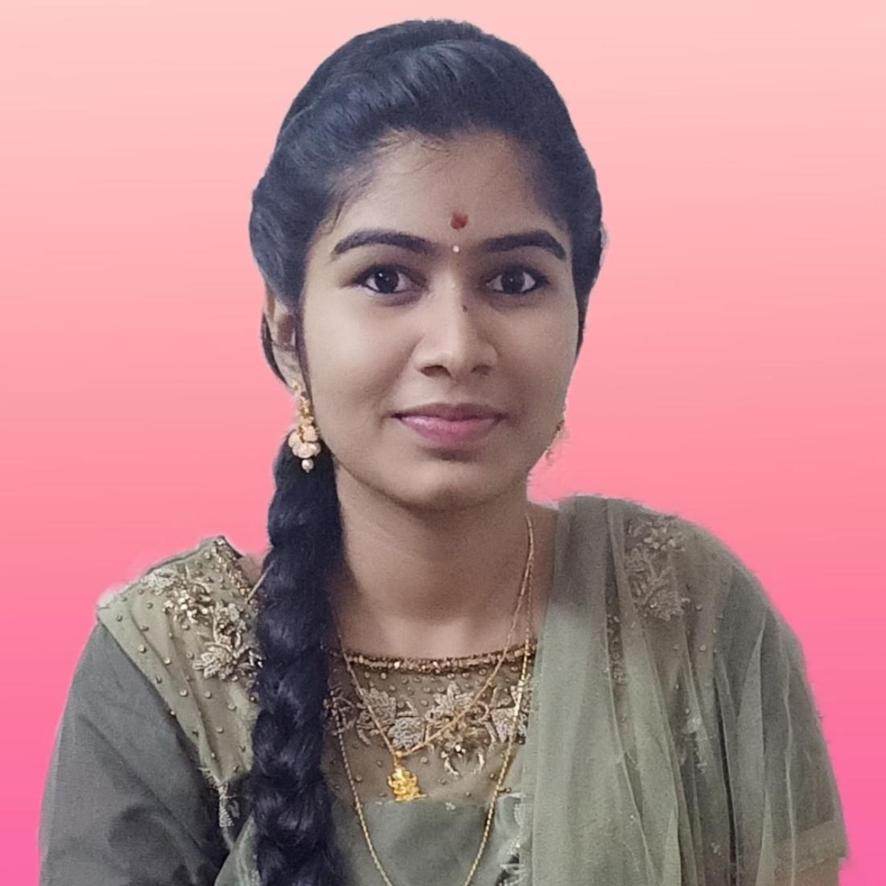



Ponnaganti Jaya Sri Latha
Analyst/Software Engineer
Bachelor of Technology
Computer Science and Engineering: 2018-2022
Bangalore
Skills
ponnaganti.jayasrilatha@capgemini.com
Java 8 /J2EE | Java Basics, OOPS, Generics, Collections, Arrays, Loops, Lambda Exp, Stream API Junit, Mockito, Servlets
Spring core | IOC & Dependency Injection, Autowire
Spring REST | REST controllers, Implementation of GET, POST, PUT & DELETE, Bean Validation & Exception Handling, Testing Services, Controller & Repository layer
Spring Data JPA | Implement DAO layer using spring Data repositories, Transaction Management
Spring Boot Microservices | Spring Boot Starters, annotations, Messaging Service, Sync/Async comms, Swagger API documents
Spring Cloud | Eureka, Netflix Ribbon, Feign Client, Netflix Hystrix, Netflix Zuul & Config Server
React | Components, Hooks, Event handling, Redux, Reducers
Database | MongoDB My SQL
UI Tech | HTML 5 & CSS 3,JavaScript, Reusable templates, Optimized UI Designed
Tools | Git, Postman, Maven, IDE
Add On skills | Communications, Team management. Peer learning
+91 8688172939
A4
Full Stack Developer
Hands on experience in creating microservices with Springboot, Spring Security, Spring Cloud API Gateway, Eureka server.
Intermediate in creating Single page Web Application in React .
React developer with working knowledge on ReactJS with react hooks, reactive forms, routing and Material UI.
Experience in creating documentation with Java docs and swagger and in unit testing using Junit, Mockito.
Development experience using Eclipse, intellij, VS Code, pgAdmin for postgres, postman Api connection and MongoDB by Atlas.
Crop Deal Application
Completed end to end case study of Crop Deal Application along with JWT authentication, Swagger and payment, Testing and responsive UI with React JS.
Seat Booking System
Developed backend applications using Monolithic Architecture and implemented all the CRUD operations using Spring Boot, Postgres, Postman and ReactJs for UI.
Check out my work on GitHub & Video Profile

